Slide 1
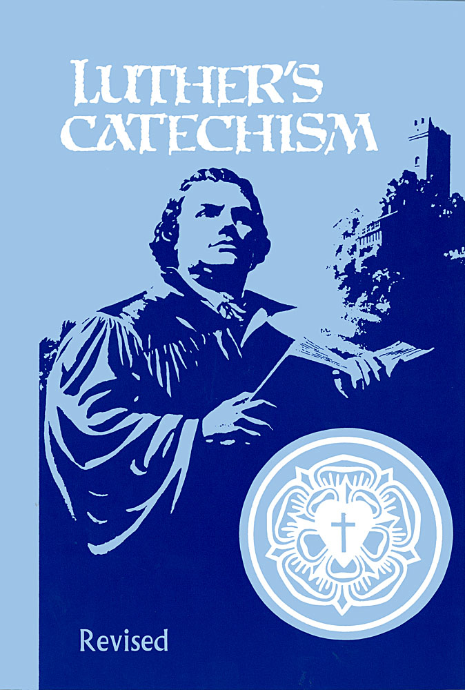
How Did God Write The Bible?
Catechism Questions 6-12
January 21, 2018

Slide 2
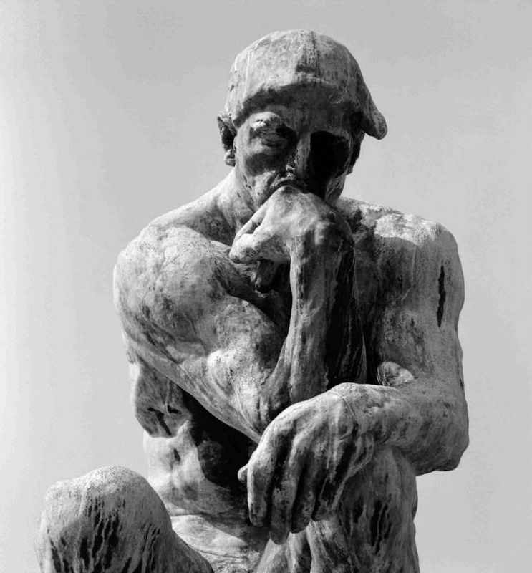
What does my natural knowledge tell me about God?
It tells me that there is a God who will judge me guilty for my sins. It is the Bible’s revealed knowledge that I find my salvation in Jesus.

Slide 3
How did God write the Bible?

Slide 4
How Did God Write The Bible?
Catechism Questions 6-12
January 21, 2018

Slide 5
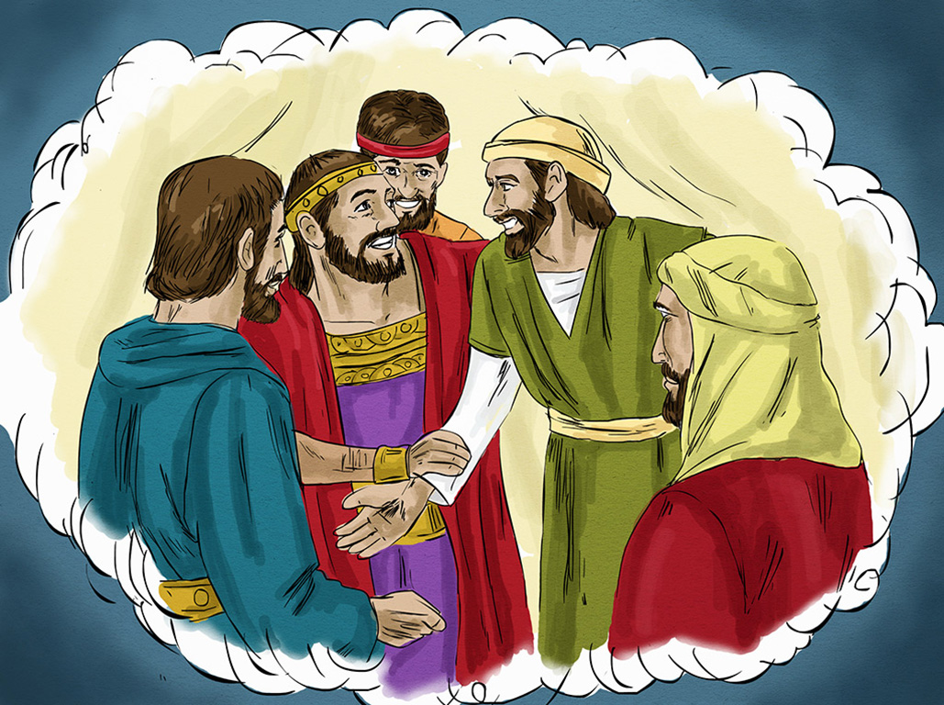
The
Rich Man And
Lazarus
Luke
16:19-31

Slide 6
What did Abraham point Lazarus’ family to so as to avoid suffering in hell?
The Old Testament – the Bible of their time.
What makes that above answer able to save?
It is God’s message which is true in all it says.

Slide 7
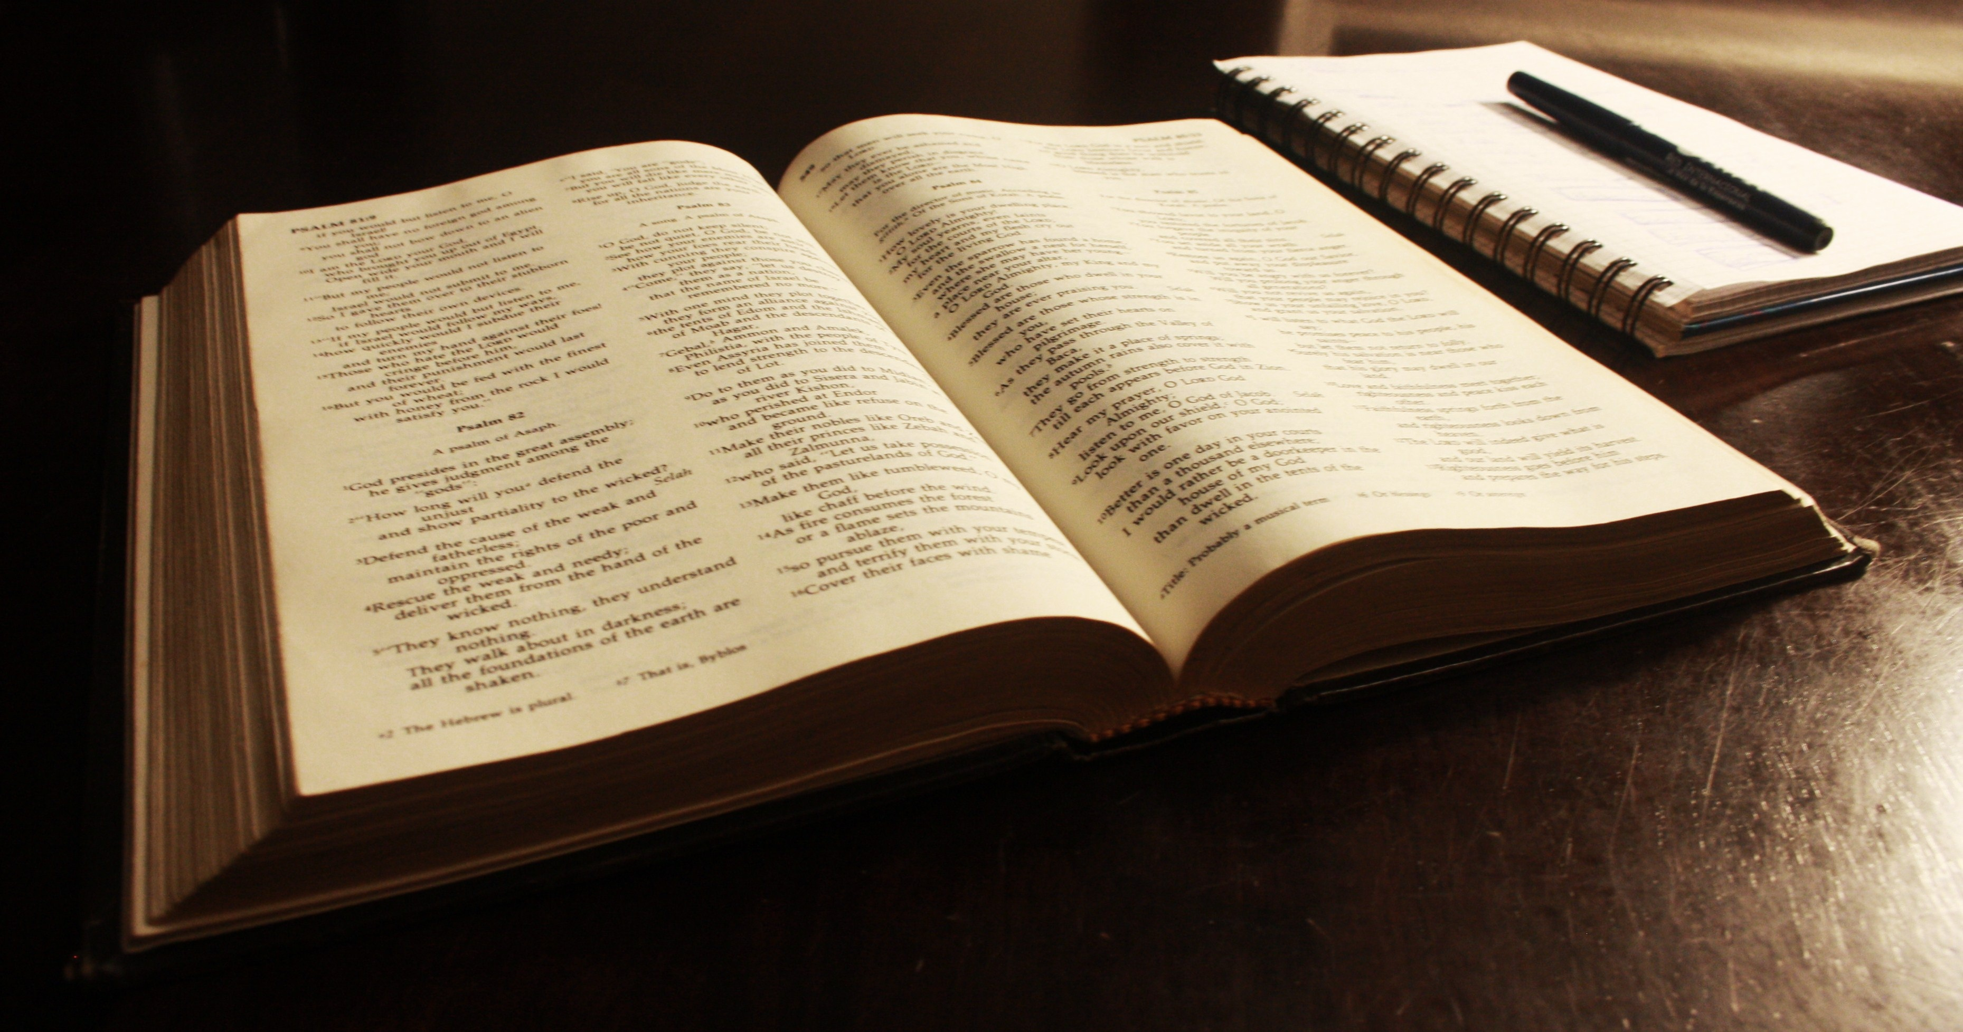
1 Thessalonians 2:13; 2 Peter 1:21

Slide 8
What do we mean when we say that God gave us the Bible by “verbal inspiration?”
“Verbal inspiration” means that the Holy Spirit guided men to record the exact words that he wanted them to write.

Slide 9
The
Rich Man And
Lazarus
Luke
16:19-31

Slide 10
John 17:17; Numbers 23:19

Slide 11
Because the Bible is verbally inspired, what can I be sure of?
It has no errors and that all its promises will be kept.

Slide 12
The
Rich Man And
Lazarus
Luke
16:19-31

Slide 13
Revelation 22:18,19; Jude 3,4

Slide 14
How will I handle God’s Word since it is verbally inspired?
I will not want to add to it, subtract from it, or change its meaning in any way.

Slide 15
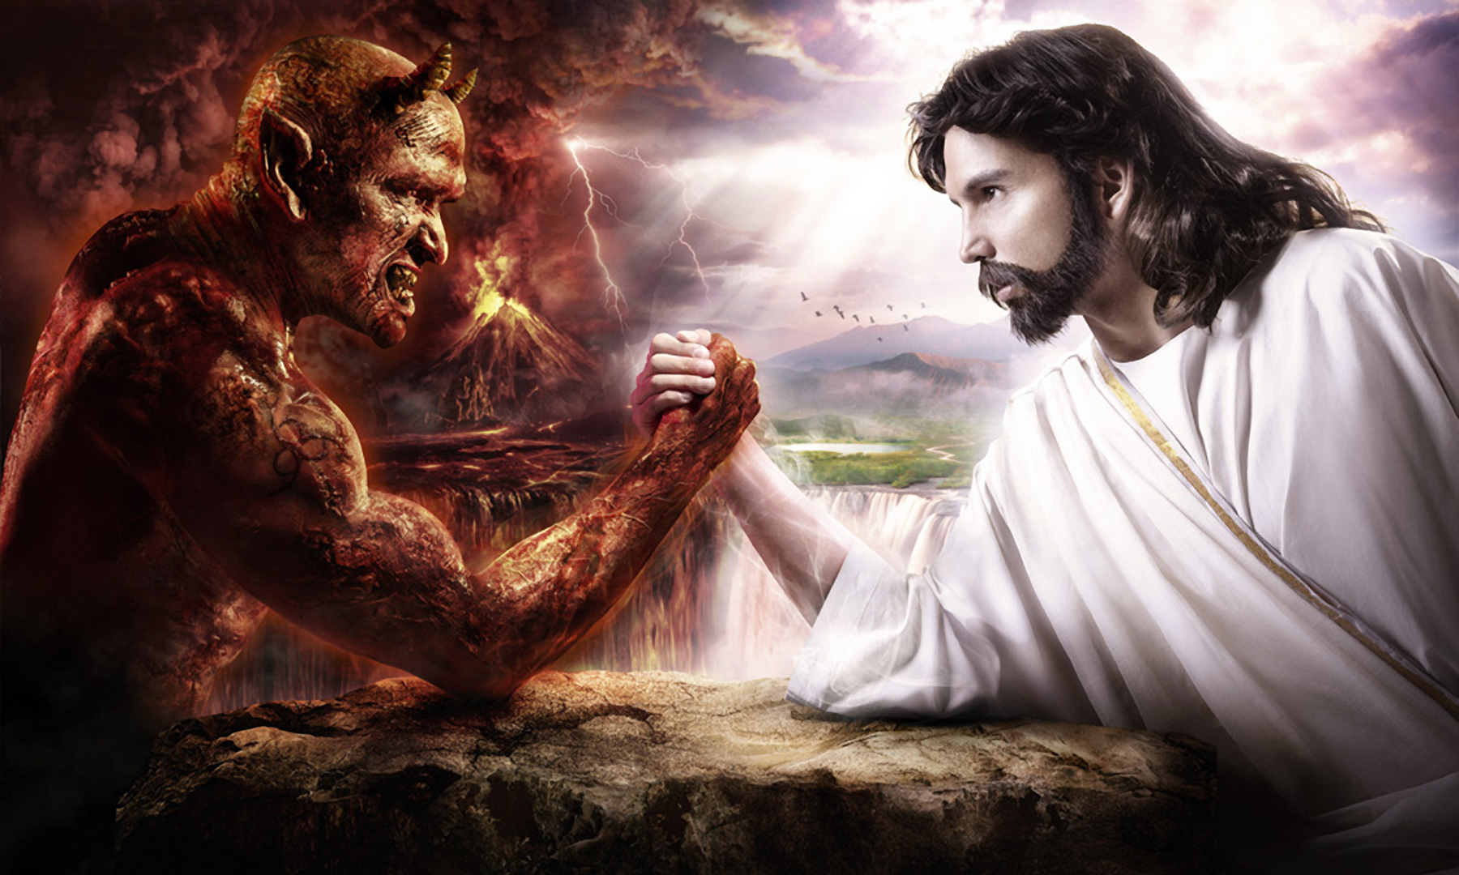
The Bible is the light of salvation for everyone who reads it.
The Bible contains the Word of God.

Slide 16
How did God write the Bible?
God wrote the Bible by verbal inspiration so that I may be sure that it is the truth and is trustworthy in all it says.

Slide 17
How Did God Write The Bible?
Catechism Questions 6-12
January 21, 2018

Slide 18


